Slide 1
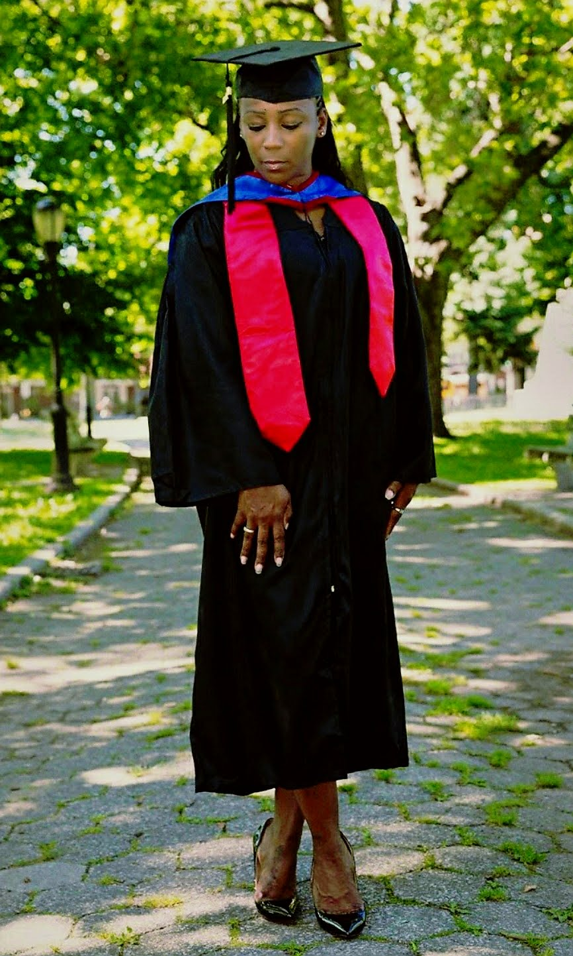
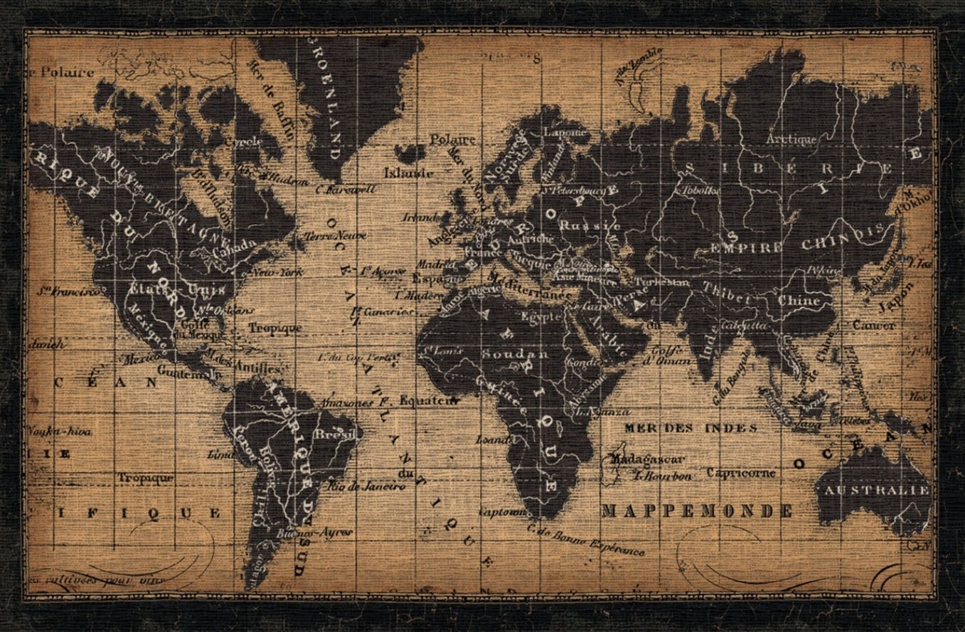
Ms. DILBERT 6th Grade SOCIAL STUDIES/SCIENCE

Slide 2
My Contact Information
Email: DilbeRe@boe.Richmond.k12.ga.us
Remind: Text the message @msdilb to the number 81010.
Google Voice: 706-785-0219
School Number: 706-592-3730

Slide 3
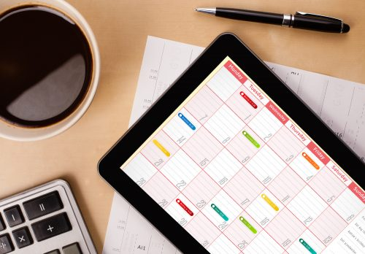
Daily Schedule
Students may start entering the building at 8:50 am. Dismissal begins at 4:05 pm.
9:20 am – 10:05 am Acceleration
10:05 am – 11:25 am 1st Period
11:25 am – 1:15 pm 2nd Period
Lunch is included in 2nd Period from 12:25 pm – 12:55 pm.
1:15 pm – 2:35 pm 3rd Period
2:35 pm – 4:05 pm Connections
Designated restroom breaks will be at 10:40 am, 12:20 am, and 2:20 pm.

Slide 4
CHECKOUT MY WEBSITE TO VIEW THE FOLLOWING INFORMATION
Class Syllabus/Supply List
Resources
Additional Information

Slide 5
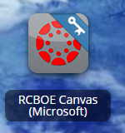
RCSS Learning Platform and Canvas
New to the Richmond County
Go to rcboe.org
Click Student
Click Launch Pad
Watch logging into Canvas as a student.
https://rcboe.instructuremedia.com/embed/048204ea-777e-4c04-9fc0-357111372c96
Your child will login through Launch Pad to access RCBOE Canvas.
Click link to watch Tutorial Video
https://www.rcboe.org/Domain/16265

